Slide 1

Solving Travelling Salesman Problem using Ant Colony Optimization
BILEL HAMZA
MOHAMED KHALIL HAMMOUDI

Slide 2
AGENDA
ACO Explained
Initial Solution
Playing with the parameters
Key findings and discussion
Optimization

Slide 3
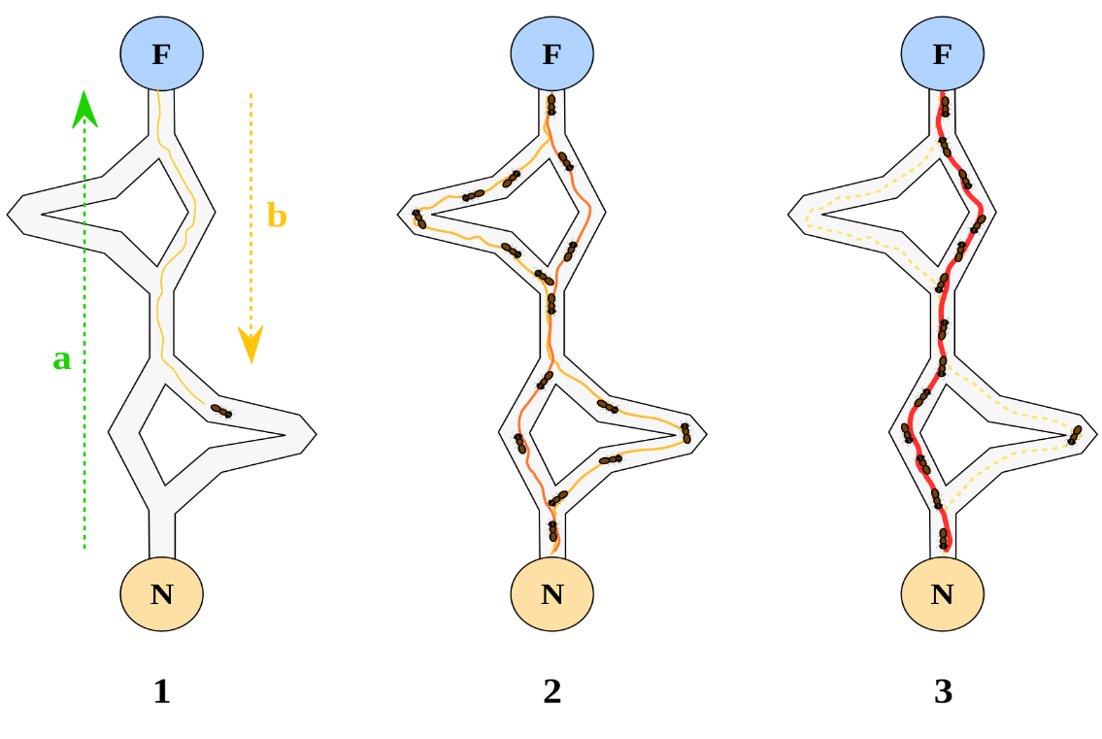
ACO Explained
ACO Parameters:
Number of iterations (Iterations),
Heuristic Information α (alpha): It represents the importance of heuristic information in the ant's decision-making process,
Heuristic Information β (beta): It determines the importance of pheromone trails in the ant's decision-making,
Pheromone Evaporation Rate (rho): It determines the pheromone’s evaporation rate

Slide 4
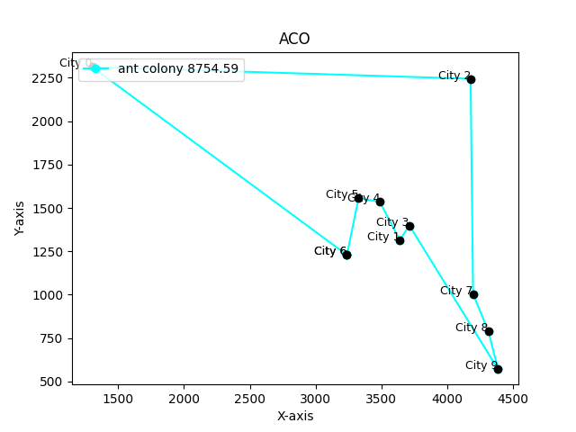
EXAMPLE
Number of city = 10
Best path from ant colony optimization:
[6, 5, 4, 1, 3, 9, 8, 7, 2, 0, 6]
shortest distance = 8754.59
CPU time = 0,21462 s

Slide 5
INITIAL SOLUTION
NUMBER_OF_ITERATIONS = 100 ; EVAPORATION_FACTOR = 0.5 ; UPDATED_PHEROMONE_VALUE = 7 ; ALPHA = 1 ; BETA = 1
Instances |  | Reference Solution | CPU Time in sec
Designation | Number of cities
TSP1 | 5 | 6 534,52180 | 0,14733
TSP2 | 10 | 8 736,39870 | 0,20286
TSP3 | 15 | 10 608,80240 | 0,68177
TSP4 | 20 | 11 685,29450 | 0,55765
TSP5 | 25 | 13 787,49410 | 1,09299
TSP6 | 30 | 15 887,78670 | 1,53025
TSP7 | 35 | 23 517,34330 | 2,30929
TSP8 | 40 | 24 525,83456 | 4,73267
TSP9 | 70 | 25 595,63400 | 18,78000
TSP10 | 130 | 36 209,67190 | 127,99490
TSP11 | 200 | 47 832,46425 | 498,92340
AVERAGE |  |  | 59,72301

Slide 6
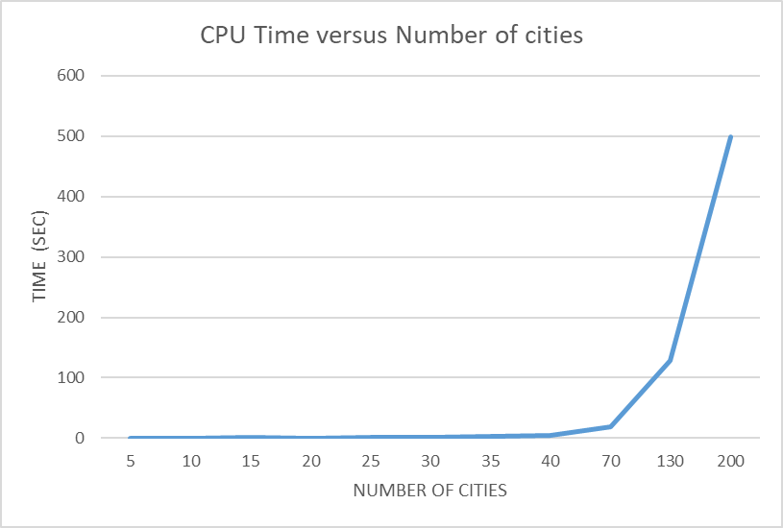
VARYING THE NUMBER OF CITIES

Slide 7
PLAYING WITH NUMBER OF ITERATIONS
NUMBER_OF_ITERATIONS = 50 ; EVAPORATION_FACTOR = 0.5 ; UPDATED_PHEROMONE_VALUE = 7 ; ALPHA = 1 ; BETA = 1
Instances |  | Reference Solution | Solution ACO | GAP% | CPU Time in seconds
Designation | Number of cities
TSP1 | 5 | 6 534,52180 | 6 534,52181 | 0,00000 | 0,06667
TSP2 | 10 | 8 736,39870 | 8 757,75180 | 0,24442 | 0,14966
TSP3 | 15 | 10 608,80240 | 10 797,11321 | 1,77504 | 0,31735
TSP4 | 20 | 11 685,29450 | 11 707,62347 | 0,19109 | 0,57955
TSP5 | 25 | 13 787,49410 | 13 678,32208 | -0,79182 | 1,05280
TSP6 | 30 | 15 887,78670 | 16 006,60365 | 0,74785 | 1,59310
TSP7 | 35 | 23 517,34330 | 24 168,06211 | 2,76697 | 2,55962
TSP8 | 40 | 24 525,83456 | 25 547,99689 | 4,16770 | 2,82133
TSP9 | 70 | 25 595,63400 | 26 497,39205 | 3,52309 | 8,94199
TSP10 | 130 | 36 209,67190 | 38 502,07578 | 6,33092 | 57,69577
TSP11 | 200 | 47 832,46425 | 48 514,19827 | 1,42525 | 221,09405
AVERAGE |  |  |  | 1,85277 | 26,98835

Slide 8
PLAYING WITH NUMBER OF ITERATIONS
NUMBER_OF_ITERATIONS = 70 ; EVAPORATION_FACTOR = 0.5 ; UPDATED_PHEROMONE_VALUE = 7 ; ALPHA = 1 ; BETA = 1
Instances |  | Reference Solution | Solution ACO | GAP% | CPU Time in seconds
Designation | Number of cities
TSP1 | 5 | 6 534,52180 | 6 534,52000 | -0,00003 | 0,04161
TSP2 | 10 | 8 736,39870 | 8 736,40000 | 0,00001 | 0,13695
TSP3 | 15 | 10 608,80240 | 10 705,03000 | 0,90705 | 0,17305
TSP4 | 20 | 11 685,29450 | 11 883,99000 | 1,70039 | 0,36367
TSP5 | 25 | 13 787,49410 | 13 523,54000 | -1,91445 | 0,69938
TSP6 | 30 | 15 887,78670 | 16 545,83295 | 4,14184 | 1,08453
TSP7 | 35 | 23 517,34330 | 24 173,77000 | 2,79125 | 1,71067
TSP8 | 40 | 24 525,83456 | 24 327,38848 | -0,80913 | 2.327373
TSP9 | 70 | 25 595,63400 | 26 521,81970 | 3,61853 | 11,62402
TSP10 | 130 | 36 209,67190 | 39 085,51309 | 7,94219 | 95,38760
TSP11 | 200 | 47 832,46425 | 48 391,65116 | 1,16905 | 408,17199
AVERAGE |  |  |  | 0,85212 | 51,93935

Slide 9
PLAYING WITH NUMBER OF ITERATIONS
NUMBER_OF_ITERATIONS = 130 ; EVAPORATION_FACTOR = 0.5 ; UPDATED_PHEROMONE_VALUE = 7 ; ALPHA = 1 ; BETA = 1
Instances |  | Reference Solution | Solution ACO | GAP% | CPU Time in seconds
Designation | Number of cities
TSP1 | 5 | 6 534,52180 | 6 534,52181 | 0,00000 | 0,17623
TSP2 | 10 | 8 736,39870 | 8 757,75180 | 0,24442 | 0,24549
TSP3 | 15 | 10 608,80240 | 10 726,38326 | 1,10833 | 0,71479
TSP4 | 20 | 11 685,29450 | 11 676,32362 | -0,07677 | 1,20737
TSP5 | 25 | 13 787,49410 | 13 553,92493 | -1,69407 | 2,88989
TSP6 | 30 | 15 887,78670 | 15 552,35111 | -2,11128 | 6,14531
TSP7 | 35 | 23 517,34330 | 23 158,43014 | -1,52616 | 6,91282
TSP8 | 40 | 24 525,83456 | 24 925,59963 | 1,62998 | 11,31991
TSP9 | 70 | 25 595,63400 | 26 448,43103 | 3,33181 | 23,05945
TSP10 | 130 | 36 209,67190 | 36 020,66704 | -0,52197 | 146,16111
TSP11 | 200 | 47 832,46425 | 46 765,26031 | -2,23113 | 699,47336
AVERAGE |  |  |  | -0,16790 | 81,66416

Slide 10
PLAYING WITH NUMBER OF ITERATIONS
NUMBER_OF_ITERATIONS = 150 ; EVAPORATION_FACTOR = 0.5 ; UPDATED_PHEROMONE_VALUE = 7 ; ALPHA = 1 ; BETA = 1
Instances |  | Reference Solution | Solution ACO | GAP% | CPU Time in seconds
Designation | Number of cities
TSP1 | 5 | 6 534,52180 | 6 534,52181 | 0,00000 | 0,18413
TSP2 | 10 | 8 736,39870 | 8 736,39871 | 0,00000 | 0,46489
TSP3 | 15 | 10 608,80240 | 10 608,80242 | 0,00000 | 0,92939
TSP4 | 20 | 11 685,29450 | 11 537,08319 | -1,26836 | 2,03387
TSP5 | 25 | 13 787,49410 | 13 628,07521 | -1,15626 | 2,97164
TSP6 | 30 | 15 887,78670 | 15 904,37908 | 0,10443 | 5,53981
TSP7 | 35 | 23 517,34330 | 23 241,44228 | -1,17318 | 7,54615
TSP8 | 40 | 24 525,83456 | 24 845,46533 | 1,30324 | 12,81974
TSP9 | 70 | 25 595,63400 | 25 948,89401 | 1,38016 | 37,27885
TSP10 | 130 | 36 209,67190 | 37 471,34793 | 3,48436 | 180,63914
TSP11 | 200 | 47 832,46425 | 47 116,93839 | -1,49590 | 666,70865
AVERAGE |  |  |  | 0,10714 | 83,37420

Slide 11
PLAYING WITH NUMBER OF ITERATIONS
NUMBER OF ITERATIONS | AVG GAP % | CPU TIME(SEC)
70 | 0,852 | 51,939
50 | 1,853 | 26,988
130 | -0,168 | 81,664
150 | 0,107 | 83,374

Slide 12
PLAYING WITH THE EVAPORATION FACTOR
NUMBER_OF_ITERATIONS = 100 ; EVAPORATION_FACTOR = 0.2 ; UPDATED_PHEROMONE_VALUE = 7 ; ALPHA = 1 ; BETA = 1
Instances |  | Reference Solution | Solution ACO | GAP% | CPU Time in seconds
Designation | Number of cities
TSP1 | 5 | 6 534,52180 | 6 534,52181 | 0,00000 | 0,13163
TSP2 | 10 | 8 736,39870 | 8 736,39871 | 0,00000 | 0,30430
TSP3 | 15 | 10 608,80240 | 10 705,03017 | 0,90706 | 0,53961
TSP4 | 20 | 11 685,29450 | 11 849,09962 | 1,40181 | 1,10424
TSP5 | 25 | 13 787,49410 | 13 108,00177 | -4,92832 | 2,69352
TSP6 | 30 | 15 887,78670 | 15 898,92126 | 0,07008 | 4,78724
TSP7 | 35 | 23 517,34330 | 23 757,01033 | 1,01911 | 5,41603
TSP8 | 40 | 24 525,83456 | 24 823,31583 | 1,21293 | 8,61940
TSP9 | 70 | 25 595,63400 | 26 262,00000 | 2,60344 | 21,59120
TSP10 | 130 | 36 209,67190 | 36 421,97000 | 0,58630 | 130,85340
TSP11 | 200 | 47 832,46425 | 48 983,71000 | 2,40683 | 488,04000
AVERAGE |  |  |  | 0,47993 | 60,37096

Slide 13
PLAYING WITH THE EVAPORATION FACTOR
NUMBER_OF_ITERATIONS = 100 ; EVAPORATION_FACTOR = 0.4 ; UPDATED_PHEROMONE_VALUE = 7 ; ALPHA = 1 ; BETA = 1
Instances |  | Reference Solution | Solution ACO | GAP% | CPU Time in seconds
Designation | Number of cities
TSP1 | 5 | 6 534,52180 | 6 534,52181 | 0,00000 | 0,11232
TSP2 | 10 | 8 736,39870 | 8 754,59416 | 0,20827 | 0,37611
TSP3 | 15 | 10 608,80240 | 10 617,23796 | 0,07951 | 0,60667
TSP4 | 20 | 11 685,29450 | 11 672,48558 | -0,10962 | 1,13402
TSP5 | 25 | 13 787,49410 | 13 635,46459 | -1,10266 | 1,33002
TSP6 | 30 | 15 887,78670 | 15 856,68087 | -0,19578 | 3,93126
TSP7 | 35 | 23 517,34330 | 24 393,04982 | 3,72366 | 5,84491
TSP8 | 40 | 24 525,83456 | 24 534,56581 | 0,03560 | 9,52417
TSP9 | 70 | 25 595,63400 | 24 938,85000 | -2,56600 | 19,43100
TSP10 | 130 | 36 209,67190 | 37 594,81580 | 3,82534 | 132,75600
TSP11 | 200 | 47 832,46425 | 48 410,52000 | 1,20850 | 485,19350
AVERAGE |  |  |  | 0,46426 | 60,02182

Slide 14
PLAYING WITH THE EVAPORATION FACTOR
NUMBER_OF_ITERATIONS = 100 ; EVAPORATION_FACTOR = 0.6 ; UPDATED_PHEROMONE_VALUE = 7 ; ALPHA = 1 ; BETA = 1
Instances |  | Reference Solution | Solution ACO | GAP% | CPU Time in seconds
Designation | Number of cities
TSP1 | 5 | 6 534,52180 | 6 534,52181 | 0,00000 | 0,13316
TSP2 | 10 | 8 736,39870 | 8 736,39871 | 0,00000 | 0,28486
TSP3 | 15 | 10 608,80240 | 10 608,80242 | 0,00000 | 0,70820
TSP4 | 20 | 11 685,29450 | 11 624,87541 | -0,00517 | 1,42126
TSP5 | 25 | 13 787,49410 | 13 477,70251 | -0,02247 | 1,82785
TSP6 | 30 | 15 887,78670 | 15 885,71078 | -0,00013 | 4,33305
TSP7 | 35 | 23 517,34330 | 23 177,11718 | -0,01447 | 5,74447
TSP8 | 40 | 24 525,83456 | 24 372,74244 | -0,00624 | 9,89046
TSP9 | 70 | 25 595,63400 | 25 741,09335 | 0,00568 | 19,34680
TSP10 | 130 | 36 209,67190 | 36 541,27342 | 0,00916 | 128,00519
TSP11 | 200 | 47 832,46425 | 48 027,31000 | 0,00407 | 494,54500
AVERAGE |  |  |  | -0,00269 | 60,56730

Slide 15
PLAYING WITH THE EVAPORATION FACTOR
NUMBER_OF_ITERATIONS = 100 ; EVAPORATION_FACTOR = 0.8 ; UPDATED_PHEROMONE_VALUE = 7 ; ALPHA = 1 ; BETA = 1
Instances |  | Reference Solution | Solution ACO | GAP% | CPU Time in seconds
Designation | Number of cities
TSP1 | 5 | 6 534,52180 | 6 534,52181 | 0,00000 | 0,13172
TSP2 | 10 | 8 736,39870 | 8 736,39871 | 0,00000 | 0,32046
TSP3 | 15 | 10 608,80240 | 10 705,03017 | 0,90706 | 0,60416
TSP4 | 20 | 11 685,29450 | 11 507,29457 | -1,52328 | 0,89523
TSP5 | 25 | 13 787,49410 | 13 990,05463 | 1,46916 | 1,98967
TSP6 | 30 | 15 887,78670 | 15 878,47553 | -0,05861 | 4,37430
TSP7 | 35 | 23 517,34330 | 23 726,78358 | 0,89058 | 5,74615
TSP8 | 40 | 24 525,83456 | 24 948,67005 | 1,72404 | 8,23696
TSP9 | 70 | 25 595,63400 | 26 255,57610 | 2,57834 | 20,45200
TSP10 | 130 | 36 209,67190 | 37 253,27010 | 2,88210 | 131,62410
TSP11 | 200 | 47 832,46425 | 46 930,10750 | -1,88649 | 487,89900
AVERAGE |  |  |  | 0,63481 | 60,20670

Slide 16
PLAYING WITH THE EVAPORATION FACTOR
EVAPORATION FACTOR | AVG GAP % | CPU TIME(SEC)
0,6 | -0,00269 | 60,56730
0,8 | 0,63481 | 60,20670
0,4 | 0,46426 | 60,02182
0,2 | 0,47993 | 60,37096

Slide 17
PLAYING WITH THE PHEROMONE VALUE
NUMBER_OF_ITERATIONS = 100 ; EVAPORATION_FACTOR = 0.5 ; UPDATED_PHEROMONE_VALUE = 4 ; ALPHA = 1 ; BETA = 1
Instances |  | Reference Solution | Solution ACO | GAP% | CPU Time in seconds
Designation | Number of cities
TSP1 | 5 | 6 534,52180 | 6 534,52181 | 0,00000 | 0,07933
TSP2 | 10 | 8 736,39870 | 8 754,59416 | 0,20827 | 0,12810
TSP3 | 15 | 10 608,80240 | 10 617,23796 | 0,07951 | 0,33488
TSP4 | 20 | 11 685,29450 | 11 685,88103 | 0,00502 | 1,20378
TSP5 | 25 | 13 787,49410 | 13 366,81075 | -3,05120 | 1,15979
TSP6 | 30 | 15 887,78670 | 15 540,47225 | -2,18605 | 1,59559
TSP7 | 35 | 23 517,34330 | 24 106,93618 | 2,50706 | 2,72521
TSP8 | 40 | 24 525,83456 | 23 927,28773 | -2,44047 | 3,98442
TSP9 | 70 | 25 595,63400 | 26 748,48264 | 4,50408 | 17,55884
TSP10 | 130 | 36 209,67190 | 37 507,41546 | 3,58397 | 215,90952
TSP11 | 200 | 47 832,46425 | 46 001,65811 | -3,82754 | 314,22766
AVERAGE |  |  |  | -0,05612 | 54,13483

Slide 18
PLAYING WITH THE PHEROMONE VALUE
NUMBER_OF_ITERATIONS = 100 ; EVAPORATION_FACTOR = 0.5 ; UPDATED_PHEROMONE_VALUE = 5 ; ALPHA = 1 ; BETA = 1
Instances |  | Reference Solution | Solution ACO | GAP% | CPU Time in seconds
Designation | Number of cities
TSP1 | 5 | 6 534,52180 | 6 534,52181 | 0,00000 | 0,07112
TSP2 | 10 | 8 736,39870 | 8 754,59416 | 0,20827 | 0,14501
TSP3 | 15 | 10 608,80240 | 10 617,23796 | 0,07951 | 0,32535
TSP4 | 20 | 11 685,29450 | 11 654,66403 | -0,26213 | 0,60263
TSP5 | 25 | 13 787,49410 | 13 571,53631 | -1,56633 | 2,18046
TSP6 | 30 | 15 887,78670 | 15 731,32200 | -0,98481 | 2,79665
TSP7 | 35 | 23 517,34330 | 23 495,94403 | -0,09099 | 3,36404
TSP8 | 40 | 24 525,83456 | 24 488,58566 | -0,15188 | 4,74072
TSP9 | 70 | 25 595,63400 | 26 143,28121 | 2,13961 | 19,65744
TSP10 | 130 | 36 209,67190 | 36 599,11250 | 1,07552 | 222,92676
TSP11 | 200 | 47 832,46425 | 47 543,26480 | -0,60461 | 766,58112
AVERAGE |  |  |  | -0,01435 | 80,04646

Slide 19
PLAYING WITH THE PHEROMONE VALUE
NUMBER_OF_ITERATIONS = 100 ; EVAPORATION_FACTOR = 0.5 ; UPDATED_PHEROMONE_VALUE = 6 ; ALPHA = 1 ; BETA = 1
Instances |  | Reference Solution | Solution ACO | GAP% | CPU Time in seconds
Designation | Number of cities
TSP1 | 5 | 6 534,52180 | 6 534,52181 | 0,00000 | 0,06291
TSP2 | 10 | 8 736,39870 | 8 754,59416 | 0,20827 | 0,15296
TSP3 | 15 | 10 608,80240 | 10 617,23796 | 0,07951 | 0,32118
TSP4 | 20 | 11 685,29450 | 11 630,60733 | -0,46800 | 0,84288
TSP5 | 25 | 13 787,49410 | 13 152,19140 | -4,60782 | 1,03730
TSP6 | 30 | 15 887,78670 | 15 858,50969 | -0,18427 | 2,19087
TSP7 | 35 | 23 517,34330 | 23 253,98609 | -1,11984 | 2,15753
TSP8 | 40 | 24 525,83456 | 24 976,71887 | 1,83841 | 4,28278
TSP9 | 70 | 25 595,63400 | 25 328,77313 | -1,04260 | 10,80585
TSP10 | 130 | 36 209,67190 | 38 390,02687 | 6,02147 | 66,51034
TSP11 | 200 | 47 832,46425 | 46 645,46437 | -2,48158 | 852,31903
AVERAGE |  |  |  | -0,15968 | 85,51669

Slide 20
PLAYING WITH THE PHEROMONE VALUE
NUMBER_OF_ITERATIONS = 100 ; EVAPORATION_FACTOR = 0.5 ; UPDATED_PHEROMONE_VALUE = 8 ; ALPHA = 1 ; BETA = 1
Instances |  | Reference Solution | Solution ACO | GAP% | CPU Time in seconds
Designation | Number of cities
TSP1 | 5 | 6 534,52180 | 6 534,52181 | 0,00000 | 0,12301
TSP2 | 10 | 8 736,39870 | 8 736,39871 | 0,00000 | 0,29995
TSP3 | 15 | 10 608,80240 | 10 617,23796 | 0,07951 | 0,60978
TSP4 | 20 | 11 685,29450 | 11 507,29457 | -1,52328 | 1,30555
TSP5 | 25 | 13 787,49410 | 13 517,60886 | -1,95746 | 2,79521
TSP6 | 30 | 15 887,78670 | 15 685,59212 | -1,27264 | 4,75197
TSP7 | 35 | 23 517,34330 | 22 664,64281 | -3,62584 | 5,13503
TSP8 | 40 | 24 525,83456 | 25 502,30853 | 3,98141 | 9,03748
TSP9 | 70 | 25 595,63400 | 25 352,31626 | -0,95062 | 29,98876
TSP10 | 130 | 36 209,67190 | 36 708,80476 | 1,37845 | 370,17403
TSP11 | 200 | 47 832,46425 | 48 060,32649 | 0,47638 | 685,49752
AVERAGE |  |  |  | -0,31037 | 100,88348

Slide 21
PLAYING WITH THE PHEROMONE VALUE
NUMBER_OF_ITERATIONS = 100 ; EVAPORATION_FACTOR = 0.5 ; UPDATED_PHEROMONE_VALUE = 9 ; ALPHA = 1 ; BETA = 1
Instances |  | Reference Solution | Solution ACO | GAP% | CPU Time in seconds
Designation | Number of cities
TSP1 | 5 | 6 534,52180 | 6 638,78394 | 1,59556 | 0,12273
TSP2 | 10 | 8 736,39870 | 8 754,59416 | 0,20827 | 0,13458
TSP3 | 15 | 10 608,80240 | 10 705,03017 | 0,90706 | 0,33814
TSP4 | 20 | 11 685,29450 | 11 687,77874 | 0,02126 | 0,60730
TSP5 | 25 | 13 787,49410 | 14 060,76555 | 1,98202 | 0,95149
TSP6 | 30 | 15 887,78670 | 15 667,70670 | -1,38521 | 1,53804
TSP7 | 35 | 23 517,34330 | 23 188,00076 | -1,40042 | 2,26434
TSP8 | 40 | 24 525,83456 | 24 883,03655 | 1,45643 | 3,32489
TSP9 | 70 | 25 595,63400 | 25 854,76990 | 1,01242 | 10,21663
TSP10 | 130 | 36 209,67190 | 37 101,25023 | 2,46227 | 89,06071
TSP11 | 200 | 47 832,46425 | 48 554,07028 | 1,50861 | 434,44298
AVERAGE |  |  |  | 0,76075 | 49,36380

Slide 22
PLAYING WITH THE PHEROMONE VALUE
UPDATED PHEROMONE VALUE | AVG GAP % | CPU TIME(SEC)
8 | -0,31037 | 100,88348
9 | 0,76075 | 49,36380
6 | -0,15968 | 85,51669
5 | -0,01435 | 80,04646
4 | -0,05612 | 54,13483

Slide 23
Key findings and discussion
Best parameters:
NUMBER_OF_ITERATIONS = 100 EVAPORATION_FACTOR = 0.6 UPDATED_PHEROMONE_VALUE = 6 ALPHA = 1 BETA = 1

Slide 24
Optimization
The Elitist Ants:
Elitist Factor:The best path found in each iteration is given an added pheromone. This is done with the ELITIST_FACTOR within the update_pheromone_and_find_best_path function.
Local Search: A simple 2-opt local search algorithm is implemented within the local_search function. It attempts to improve the best trail by reversing segments of the path.
Total Distance Calculation: This function is defined to calculate the total distance of a given trail, making it convenient to update the pheromones based on the trail lengths.

Slide 25
Optimization
Instances |  | Reference Solution | Solution ACO | GAP% | CPU Time in seconds
Designation | Number of cities
TSP1 | 5 | 6 534,52180 | 6 066,28230 | -7,16563 | 0,02130
TSP2 | 10 | 8 736,39870 | 8 667,50772 | -0,78855 | 0,05303
TSP3 | 15 | 10 608,80240 | 10 671,41735 | 0,59022 | 0,13580
TSP4 | 20 | 11 685,29450 | 13 122,22470 | 12,29691 | 0,27128
TSP5 | 25 | 13 787,49410 | 17 887,32662 | 29,73588 | 0,69938
TSP6 | 30 | 15 887,78670 | 19 534,16620 | 22,95083 | 1,08453
AVERAGE |  |  |  | 9,60328 | 0,37755
TSP7 | 35 | 23 517,34330 | 20 520,11509 | -12,74476 | 1,28620
TSP8 | 40 | 24 525,83456 | 21 461,30733 | -12,49510 | 1.859559
TSP9 | 70 | 25 595,63400 | 25 459,65646 | -0,53125 | 85,96299
TSP10 | 100 | 34 356,62000 | 33 545,87789 | -2,35978 | 79,75878
TSP11 | 130 | 36 209,67190 | 36 960,81000 | 2,07441 | 215,88805
TSP12 | 200 | 47 832,46425 | 45 645,96074 | -4,57117 | 397,10445
TSP13 | 230 | 52 755,30291 | 51 843,09913 | -1,72912 | 750.71924
TSP14 | 300 | 63 777,27000 | 58 781,00000 | -7,83394 | 880.77066
AVERAGE |  |  |  | -5,02384 | 156,00009
Number of cities < =30: ACO
Number of cities >30 : Elitist Ants

Slide 26
Some use of ACO in CNN
Determining the best number of layers (see MNIST code)
Initializing the initial weights
Selecting features:
See: OPTIMIZATION OF ARTIFICIAL NEURAL NETWORKS USING ANT COLONY OPTIMIZATION TO IDENTIFY SIGNATURE IMAGES
See: ANT COLONY OPTIMIZATION-ENABLED CNN DEEP LEARNING TECHNIQUE FOR ACCURATE DETECTION OF CERVICAL CANCER

Slide 27
Thanks for your attention !

